Slide 1
Analyzing System Memory

Slide 2
Memory evidence overview:
When discussing analyzing the memory of a system, there are two terms that are used
interchangeably. The first is RAM. RAM is the portion of the computer internal systems
where the operating system places data utilized by applications and the system hardware
while that application or hardware is in use. What makes RAM different from storage is the
volatile nature of the data. Often, if the system is shut off, the data will be lost. RAM contains:
Running processes
Loaded Dynamic Link Libraries(DLL)
Open Registry Keys
Network connections

Slide 3
Memory analysis methodology
When examining system memory, it is advisable for analysts to follow a methodology
SANS(SysAdmin, Audit, Network, and Security) six-part methodology:
Identify rogue processes
Analyze process DLLs and handles:
Review network artifacts:
Look for evidence of code injection:
Check for signs of a rootkit:
Dump suspicious process and drivers:

Slide 4
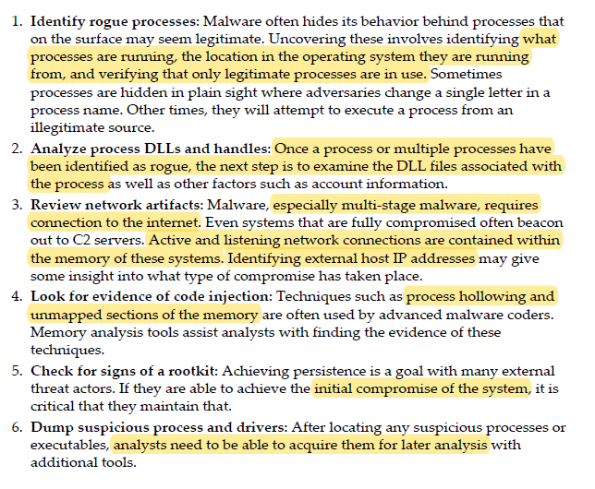

Slide 5
Network connections methodology
Suspicious network connections:
Process name:
Parent process ID:
Associated entities:

Slide 6
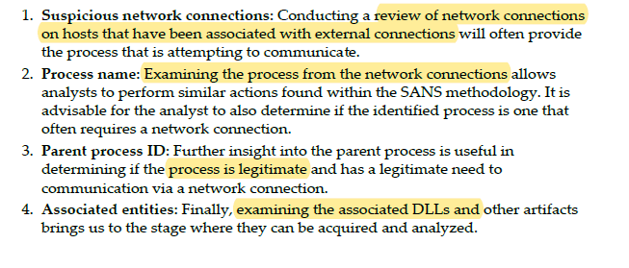

Slide 7
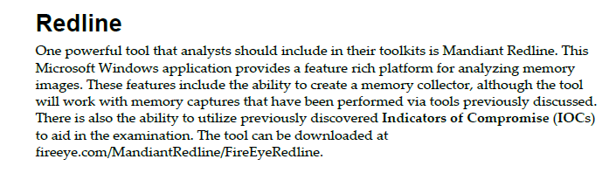
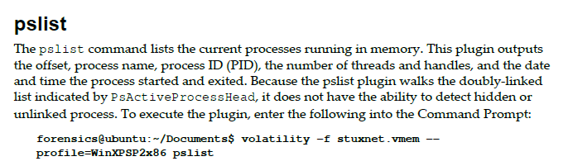
Tools
Follow the steps from reference book.

Slide 8
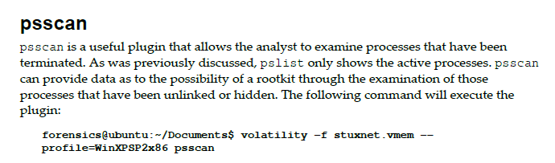
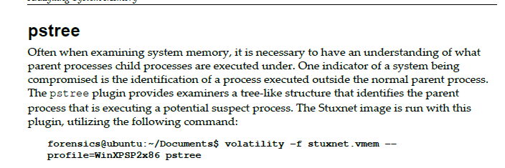


Slide 9
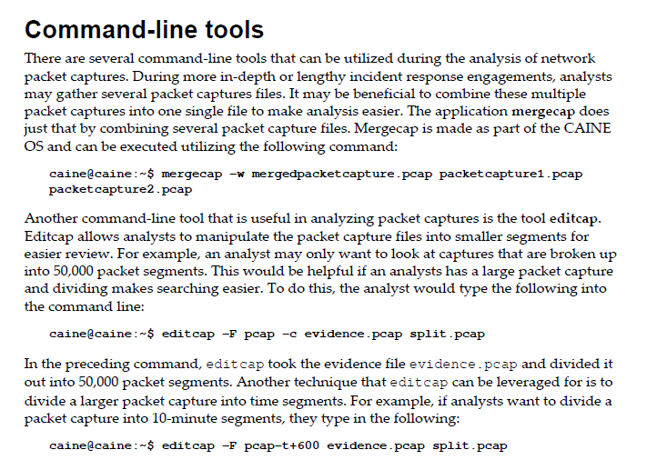
Network Evidence Analysis

Slide 10
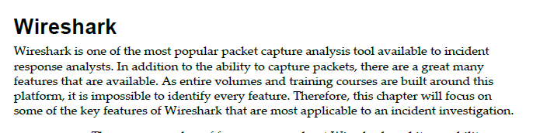
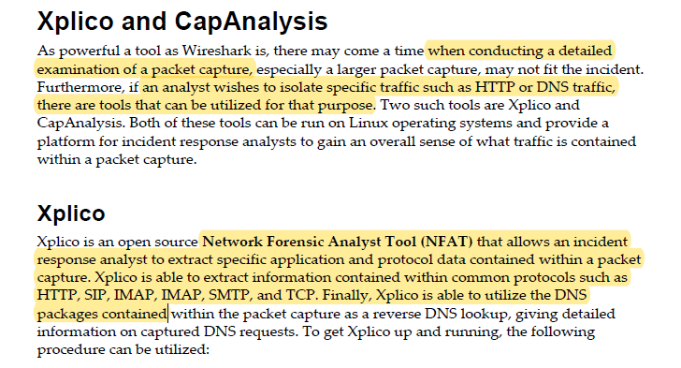

Slide 11

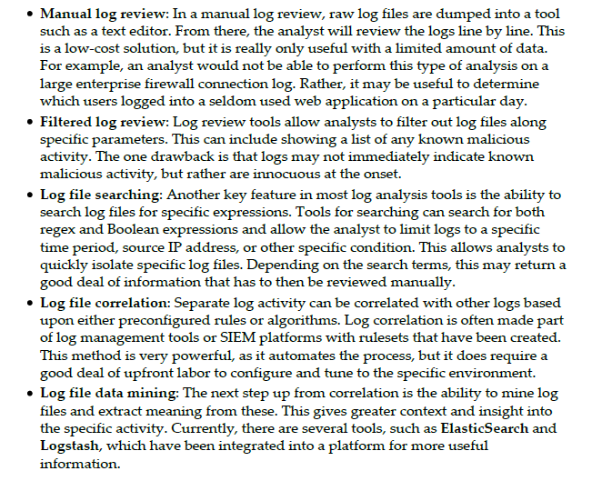

Slide 12
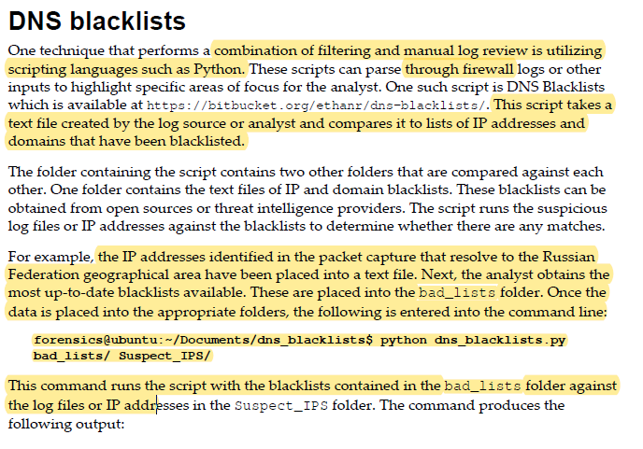

Slide 13
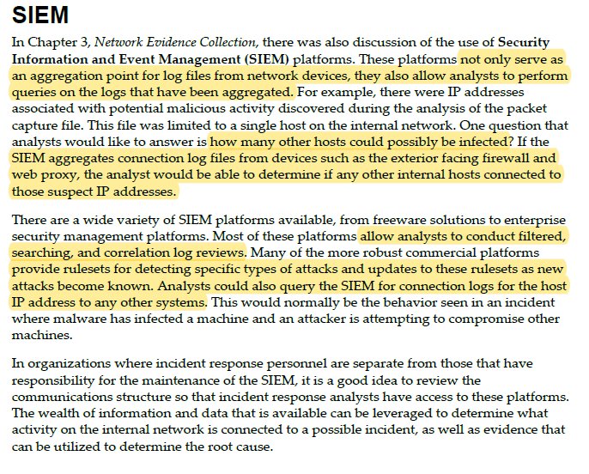

Slide 14
